Slide 1
Schizoaffective disorder in Virtual Reality
Amy Felix
2022

Slide 2
Intro
Schizoaffective disorder definition
Sample Study
Treatment

Slide 3
What is Schizoaffective Disorder
Psychotic disorder with features of a mood disorder
Hallucinations and delusions not caused by drugs or medical conditions
Major depressive disorder
Bipolar disorder
Persistent depressive disorder
Cyclothymia
Or seasonal affective disorder (SAD)
According the National Center for Biotechnology Information (NCBI), 50% of schizophrenics also struggle with depression

Slide 4
Living with Schizoaffective Disorder
Phrase one (Early signs of psychosis)
Prondrome phrase, little uncomfortable or disrupted
Flashes of paranoia
Problems concentrating
Depression,
Insomnia
Anxiety
Pulling away from family and friends
Phrase two (acute stage)
Distressing, delusions
Confused, constantly thinking
Feel removed from reality, fixed on religion or thinking others are out to get them
Hearing voices telling them they’re rotten people
Talking to people who are not even there, like spirits or imagen friends

Slide 5
How having symptoms of a mood disorder and psychosis?
The person might feel like their mind is in a haunted house with multiple unpredictable ghosts popping up.
Other people express they feel like they are constantly trying to find their place in their own mind.
According to the National Institute of Health (NIH) reports the schizoaffective disorder creates extreme shifts in behavior, mood, and energy.

Slide 6
Schizoaffective Disorder Bipolar Type
Demonstrates manic episodes and depressive episodes
Experiences high episodes of mania as well as deep depression compare to someone who is diagnosed with one of the followings
Signs of Mania
Increased energy or Hyperactivity
Irritability
Insomnia
Reckless behavior
Day to day - a person is shown to snap at other people than usual, unable to sit still, or believing one is a superhero.

Slide 7
Schizoaffective Disorder Depressive Episodes
Signs of depression:
Low energy
Problems concentrating
Hopeless
Poor hygiene
Lack to continue daily attactives
They are more valuable to drugs, isolation, and suicidal thoughts

Slide 8
Research Questions
Can the user be able identity anything unusual from sample one and sample two?
Are users able to identity some events that can affect someone with mental disorder?
Did the bright lights cause any type of feeling during the experiment?

Slide 9
Positive Outcome
According to the NCBI, these following steps have manage to help people with this order have a healthy and stable life.
Life skills training
Therapy
Medications

Slide 10
Last Phase
Phase three (recovery)
With treatment and intervention, majority who have a psychotic break will never have another episode their life again

Slide 11
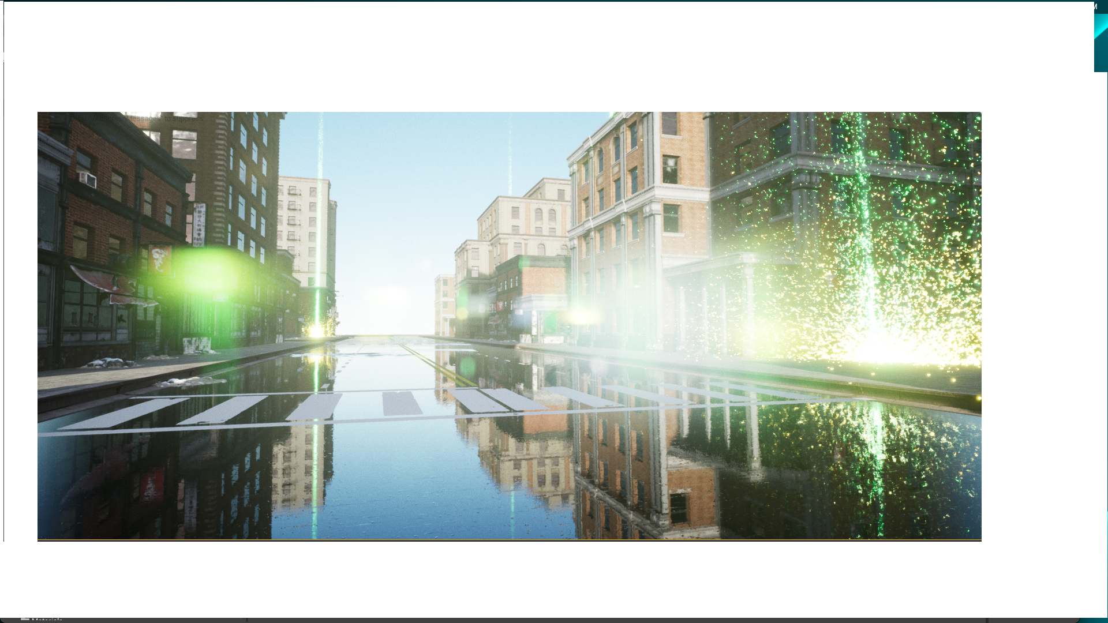
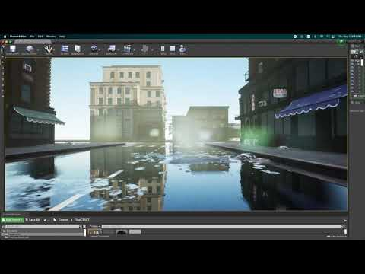
Setup
Preview
Experiment

Slide 12

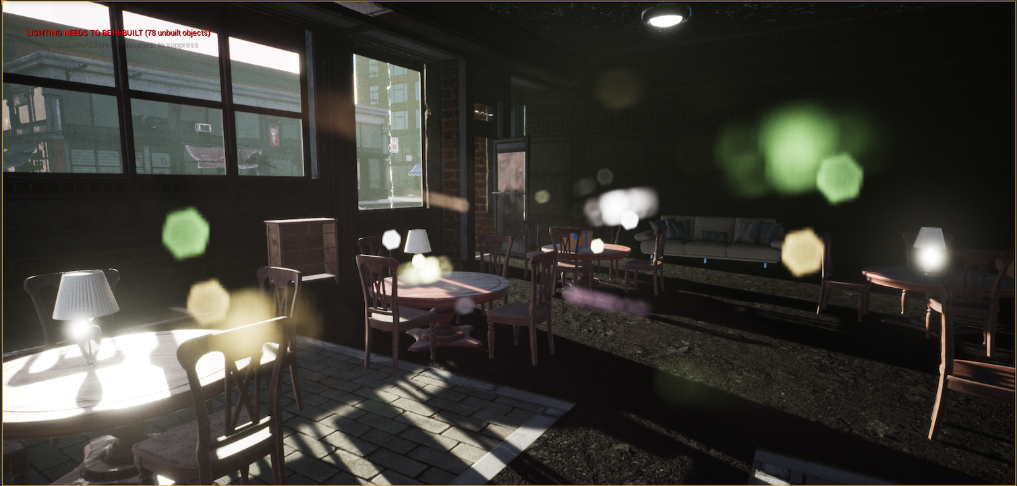
Instructions
Implemented:
Sound of rain and thunder
Lightning near the coffee shop
Raindrop effect on the streets
Glares on some angles
Snow on corners of the street
Removed clouds
Starting Point
Destination

Slide 13
THANK YOU
Questions

